Slide 1
Olist Store Analysis
---*Group 5 presentation*---

Slide 2


Team members
Syed Nishad anjum
Rakshita verma
Pavithra j
Rahul Ganesh
Vishakha Gunavant Desale

Slide 3
Overview
Olist is a Brazilian e-commerce platform that connects small and medium-sized businesses with major online marketplaces. By providing a comprehensive suite of tools and services
Olist is a prominent e-commerce platform founded in 2015, based in Brazil.

Slide 4




Datasets vs Tools used
Customer data
Order data
Product data
Payment data
Review data
Order items data
Geolocation data
Product translation data
Sellers data
Excel
Power bi
Tableau
Mysql

Slide 5
Challenges faced:
Data Quality and Cleaning:
Inconsistent Data: The dataset may contain inconsistencies such as duplicate entries, missing values, or incorrect data types, which require thorough cleaning.
Data Integration: Combining data from different sources (e.g., sales, customer reviews, product information) can be complex and time-consuming.
2.Handling Large Volumes of Data:
Performance Issues: Analyzing large datasets can lead to performance bottlenecks, especially when using tools that are not optimized for big data.
Storage and Processing: Efficiently storing and processing large volumes of data requires robust infrastructure and sometimes specialized tools.
3.Complex Data Relationships:
Relational Complexity: Understanding and managing the relationships between different tables (e.g., orders, customers, products) can be challenging.
Normalization and Denormalization: Deciding the right level of normalization to balance performance and complexity is crucial.

Slide 6
4.Advanced Analytics and Modeling:
Feature Engineering: Creating meaningful features from raw data for predictive modeling can be difficult and requires domain expertise.
Model Selection and Validation: Choosing the right models and validating them to ensure they generalize well to unseen data is a critical step.
5.Visualisation:
Effective Visualization: Creating visualizations that accurately represent the data and are easy to interpret can be challenging.
Actionable Insights: Translating complex data analysis into actionable business insights requires a deep understanding of the business context and effective communication skills.

Slide 7
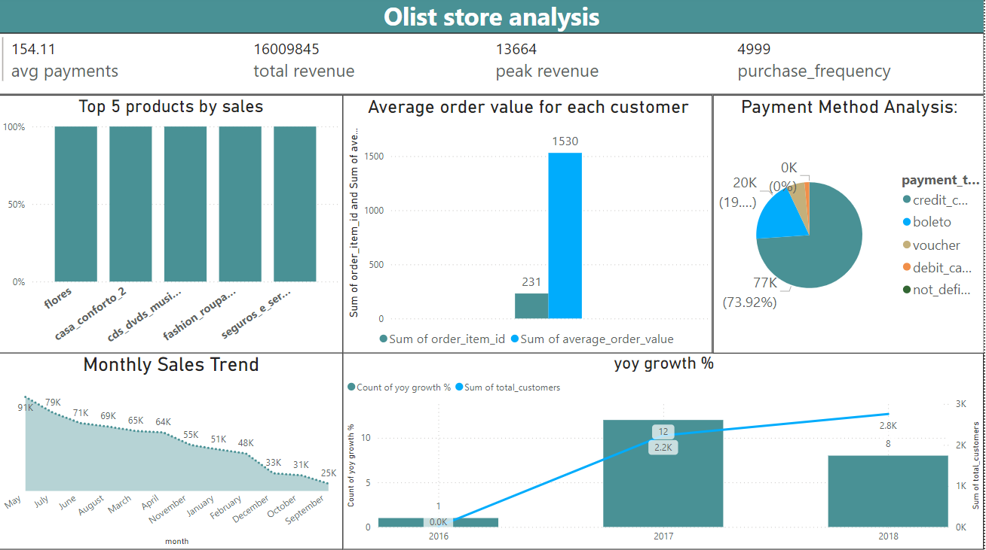

Slide 8
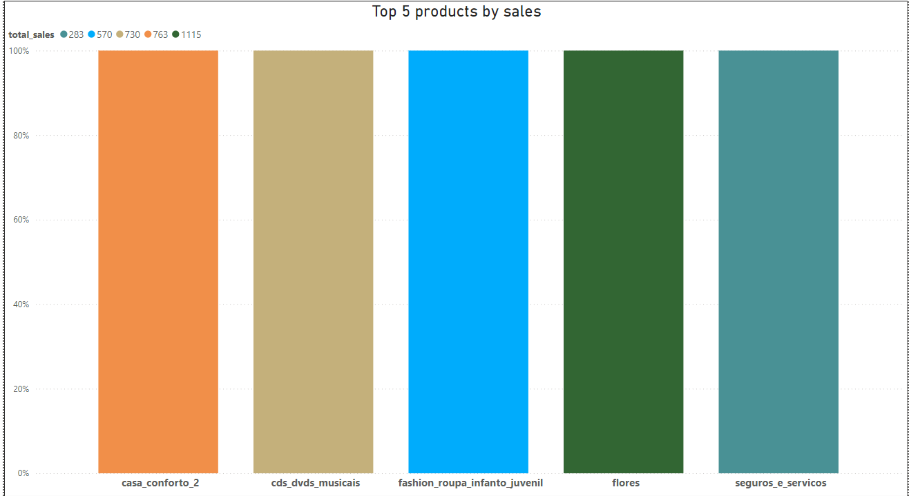
Top 5 products by sales
Product Categories: The chart displays five product categories: ‘casa conforto,’ ‘cds dvds musicais,’ ‘fashion roupa infantil juvenil,’ ‘flores,’ and ‘seguros e serviços.’
Sales Proportions: Each bar represents the percentage of total sales for each category. ‘Fashion roupa infantil juvenil’ leads with 30%, followed by ‘casa conforto’ at 25%, ‘cds dvds musicais’ at 20%, ‘seguros e serviços’ at 15%, and ‘flores’ at 10%.

Slide 9
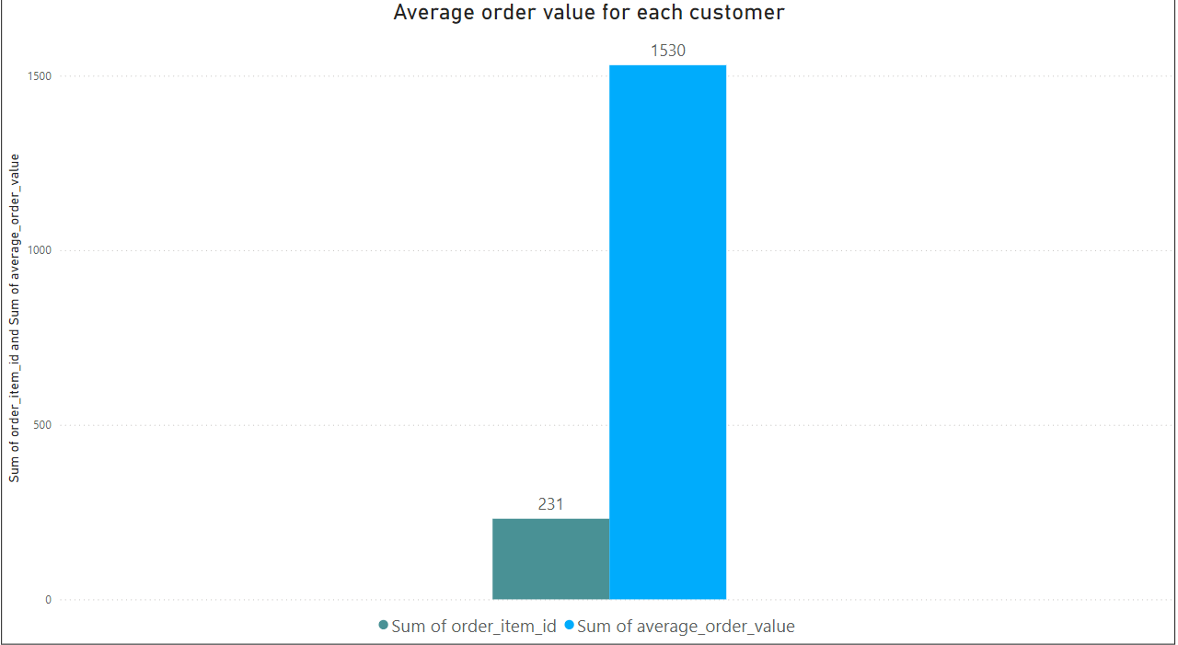
Average order value by each customer
Comparison of Sums: The chart compares two sums: the sum of order_item_id and the sum of average_order_value. The sum of average_order_value is significantly higher.
Numerical Values: The sum of average_order_value is 1530, while the sum of order_item_id is 231, indicating a substantial difference between the two metrics

Slide 10
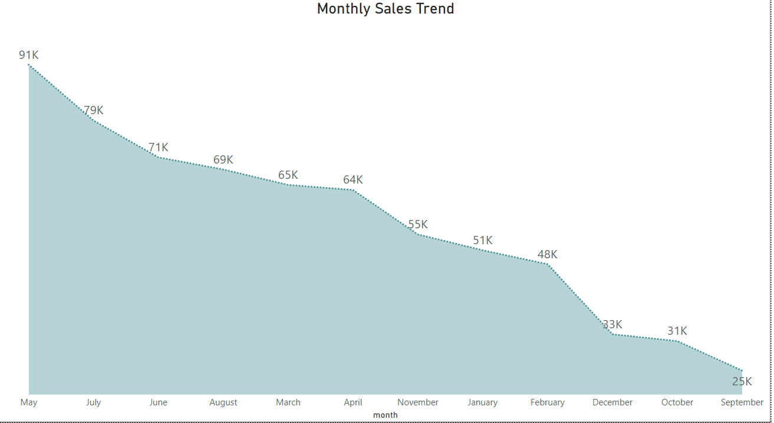
Monthly sales trend
Initial Peak: The highest sales point is at the beginning of the period, with sales reaching up to 91K units. This indicates a strong start in sales performance.
Consistent Decline: There is a noticeable downward trend in monthly sales over time, suggesting a decrease in performance or demand as the months progress.
Lowest Point: The lowest sales point occurs at the end of the period, with sales dropping to 31K units. This significant decline highlights a potential issue that may need to be addressed.

Slide 11
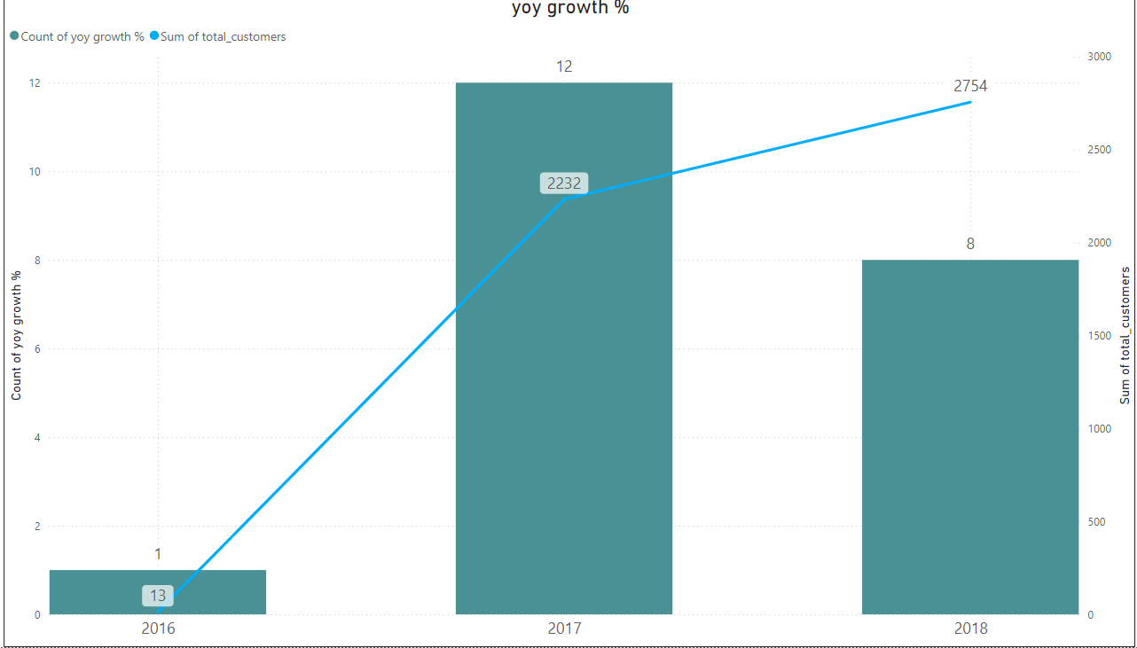
Yoy growth %
Significant Customer Growth in 2017: The sum of total customers saw a dramatic increase from 2016 to 2017. In 2016, there were only 13 total customers, but this number surged to 2232 in 2017. This indicates a substantial expansion in the customer base during this period.
Exponential YOY Growth Percentage: The YOY growth percentage also experienced an exponential rise from 2016 to 2017. The line graph shows a steep incline, reflecting the significant growth in customer acquisition. Although the exact percentage is not provided, the visual suggests a very high growth rate due to the low base in 2016.
Moderate Growth in 2018: While there was still an increase in the total number of customers in 2018, reaching around 2754, the growth rate was less pronounced compared to the previous year. The line graph indicates a notable drop in the YOY growth percentage, suggesting a period of stabilization or slower growth after the initial surge.

Slide 12
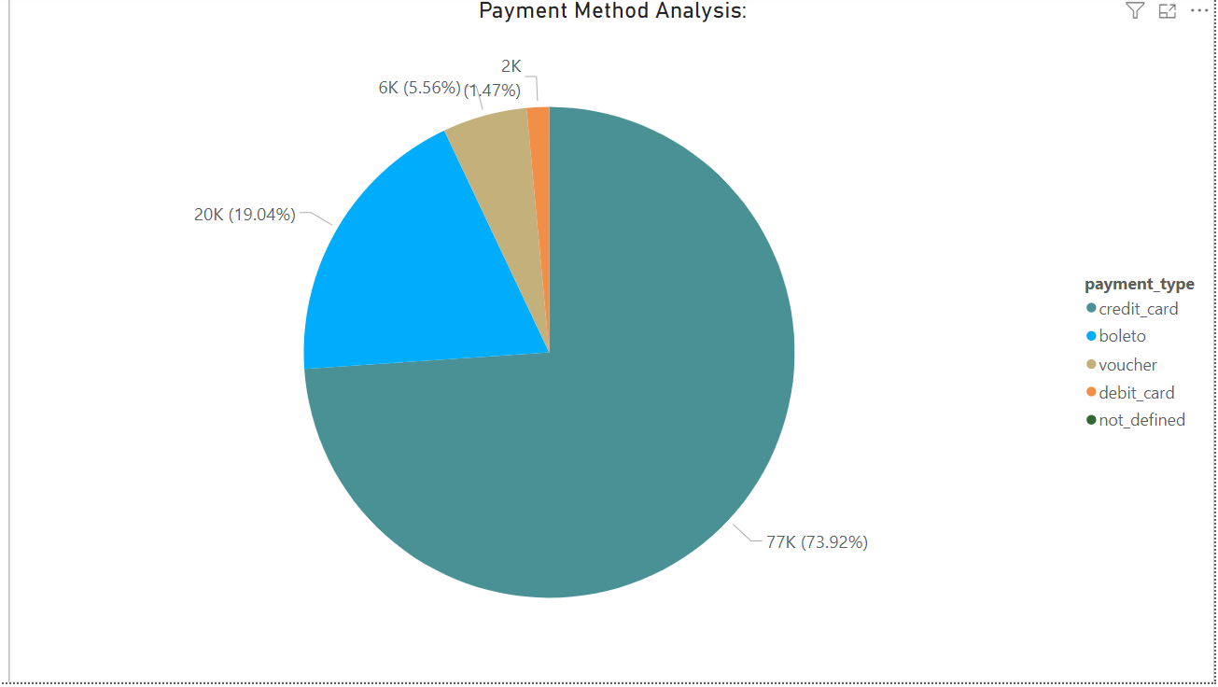
Payment method analysis
Credit Card Dominance:
High usage
Impact on sales
Significant Use of Boleto:
Second most popular
Customer segmentation
Correlation with Review Scores:
Credit card and high reviews
Insights for Improvement:

Slide 13
Thank you

